Slide 1
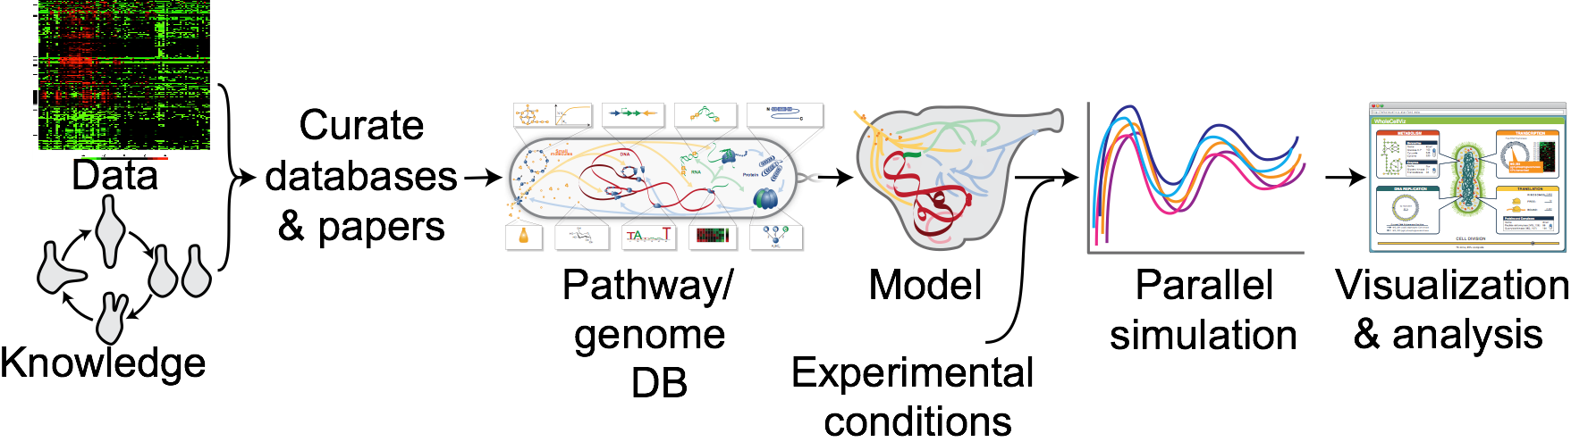

Systemizing and accelerating whole-cell modeling
KarrLab.org
karr@mssm.edu
Jonathan Karr
April 8, 2016

Slide 2








WC modeling principles
Temporally
complete
Single-cell
Species-specific
Mechanistic/dynamic
Genetically
complete
Stochastic
Molecularly
precise
Accurate
Karr et al., 2015
Notes:
Toward this goal we have built a gene-complete, computational model of a single bacterial cell which
Integrates all cellular processes into a single computational model, providing a unified understanding of cellular physiology, which
Predicts the dynamics of every molecule and process,
Can be used to guide experimental design and inform data analysis
Hopefully in the future, in concert with emerging genome-scale DNA synthesis techniques, can be used to guide rational engineering of biological systems

Slide 3
WC modeling = genomics + integrative modeling
Molecular data
Integrative model
Notes:
A central challenge in cell biology is to understand the molecular basis of cellular behaviors, that is:
to understand how cellular behaviors arise from the interactions of biomolecules,
to understand how cellular processes are controlled and coordinated at the molecular level,
to understand how cells allocate limited molecular resources for growth and maintainence,
and more.

Slide 4
WC modeling process
Characterize organism
Aggregate data
Organize data
Design submodels
Merge submodels
Simulate model
Estimate parameters
Verify model
Validate model
Visualize/analyze predictions
Applications: Engineering, medicine

Slide 5
Limitations of existing methods
Limited scope and accuracy
Don’t represent several cell functions
Don’t predict several phenotypes
Methods are not rigorous
Multi-algorithm simulation
Parameter estimation
Verification
Model reduction
Time-consuming to construct
Curate data
Design model
Verify model
Hard to understand, reuse, reproduce

Slide 6
Systemizing and accelerating WC modeling
Characterize organism
Aggregate data
Organize data
Design submodels
Merge submodels
Simulate model
Estimate parameters
Verify model
Validate model
Visualize/analyze predictions
Applications: Engineering, medicine

Slide 7
1. Characterize organism

Slide 8
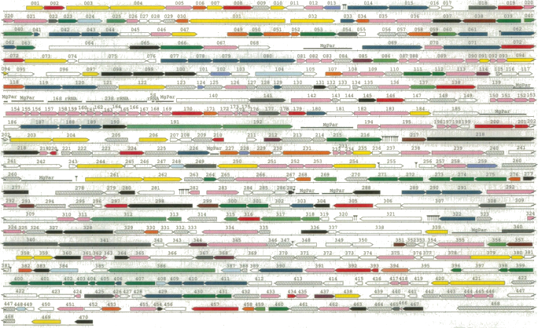
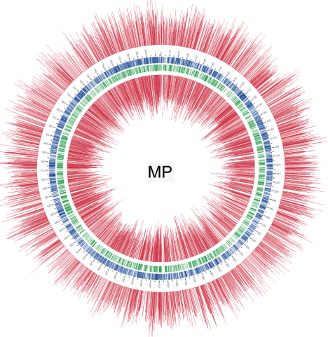
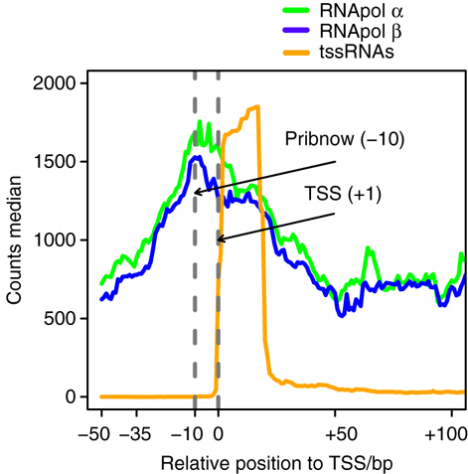
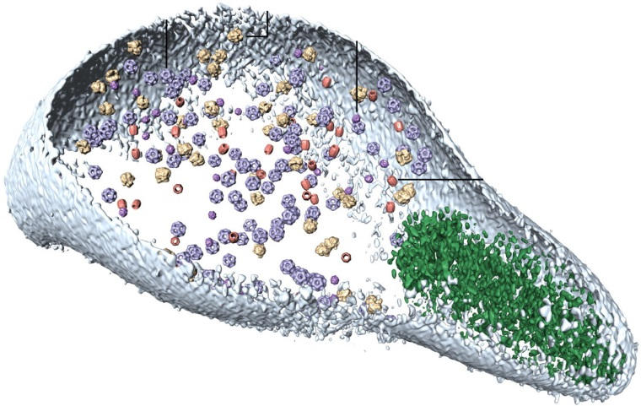
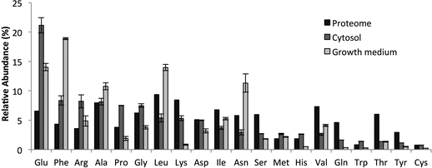
1. Characterize organism
Genome
DNA-seq
Epigenome
Meth-seq
Transcriptome
RNA-seq
Proteome
Mass-spectrometry
Metabolome
Mass-spectrometry
Fraser et al., 1995; Kühner et al., 2009; Lluch-Senar et al., 2013; Maier et al., 2013; Yus et al. 2012

Slide 9
1. Characterize organism
Chaperones
Complex composition
DNA binding sites
DNA footprints
DNA methylation
DNA sequence
Gene-drug interactions
Genome annotation
Growth rates
Metabolite concentrations
Protein cofactors
Protein expression
Protein half-lives
Protein localization
Protein modification
RNA editing
RNA expression
RNA half-lives
RNA modification
RNA maturation
Reaction fluxes
Reaction kinetics
Reaction stoichiometries
Signaling pathways
DNA mutations

Slide 10
2. Aggregate data

Slide 11
2. Aggregate data
 | Data type | Source
Baseline | Chaperones | Literature
 | Complex composition | Human Soluble Protein Complexes DB
 | DNA binding sites | TRANSFAC, AnimalTFDB
 | DNA footprints | Literature
 | DNA methylation | MethBase
 | DNA sequence | Genome Reference Consortium
 | Gene-drug interactions | DrugBank, PharmaGKB
 | Genome annotation | Ensembl
 | Growth rates | Hapmap, NCI-60
 | Metabolite concentrations | Human Metabolome Database
 | Protein cofactors | UniProt
 | Protein expression | Human Protein Atlas
 | Protein half-lives | Literature
 | Protein localization | Human Protein Atlas
 | Protein modification | Human Protein Reference DB
 | RNA editing | RADAR, DARNED
 | RNA expression | GEO, Human Protein Atlas
 | RNA half-lives | Literature
 | RNA modification | RNA Modification DB, MODOMICS
 | RNA maturation | RNApathwaysDB
 | Reaction fluxes | Literature
 | Reaction kinetics | SABIO-RK, BRENDA
 | Reaction stoichiometries | Recon X, UniProt, HumanCyc
 | Signaling pathways | Literature
Disease | DNA mutations | CCLE, COSMIC
 | DNA methylation | TCGA
 | Gene-drug interactions | CCLE
 | Growth rates | NCI-60
 | Metabolite concentrations | Literature
 | Protein expression | TCGA
 | RNA expression | CCLE

Slide 12
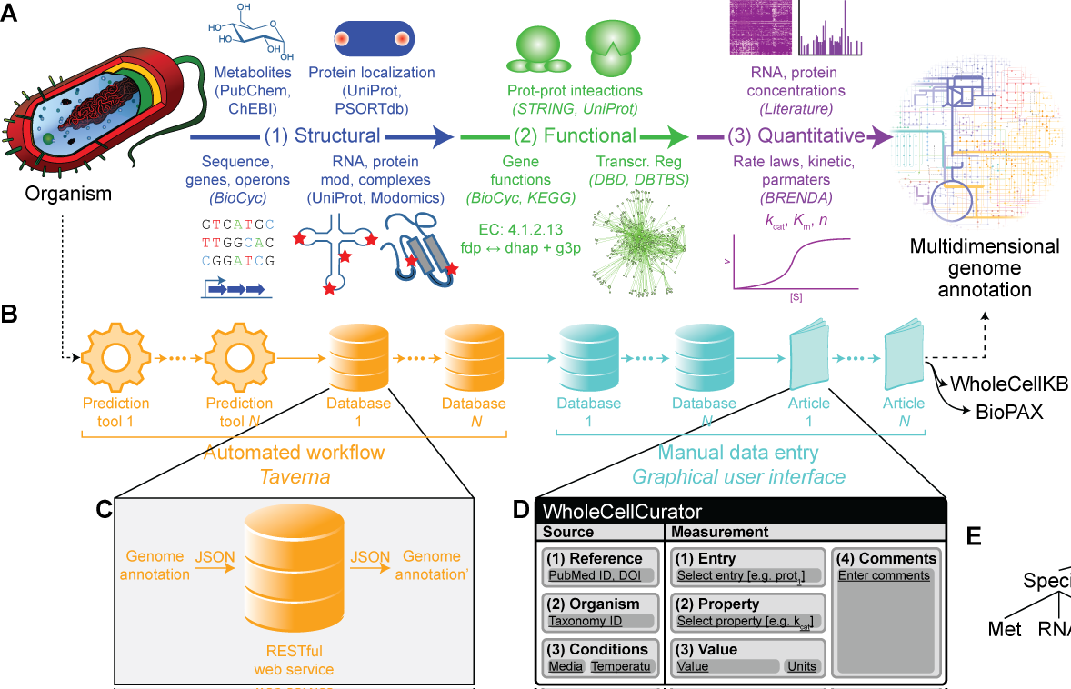
2. Aggregate data

Slide 13
3. Organize data

Slide 14






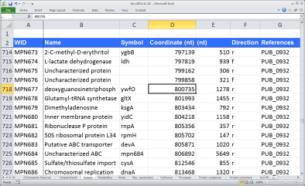
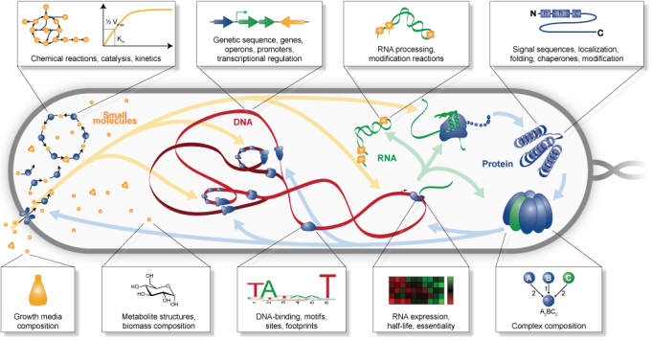
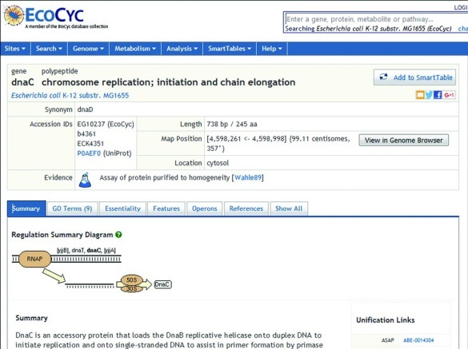
3. Organize data
Aggregate data: Scripts, Excel
PGDB: Pathway Tools, WC-KB
PGDB Browser
Caspi et al., 2016

Slide 15
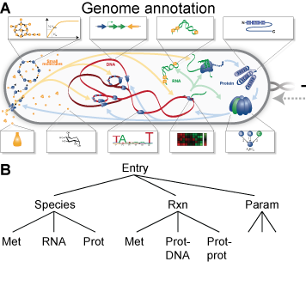
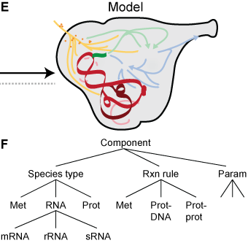
3. Organize data

Slide 16
4. Design submodels

Slide 17
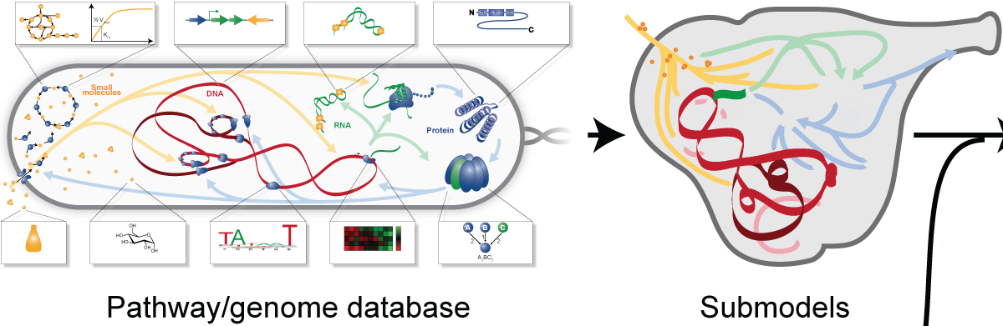
4. Design submodels

Slide 18
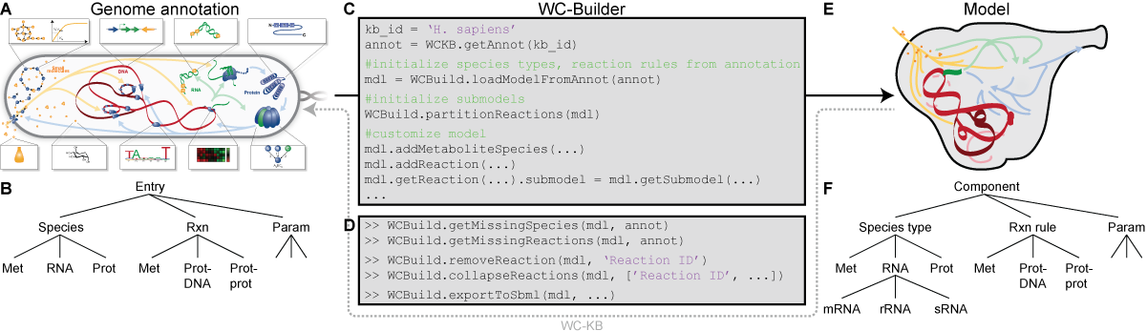
4. Design submodels
WC-ML, SBML, CellML

Slide 19
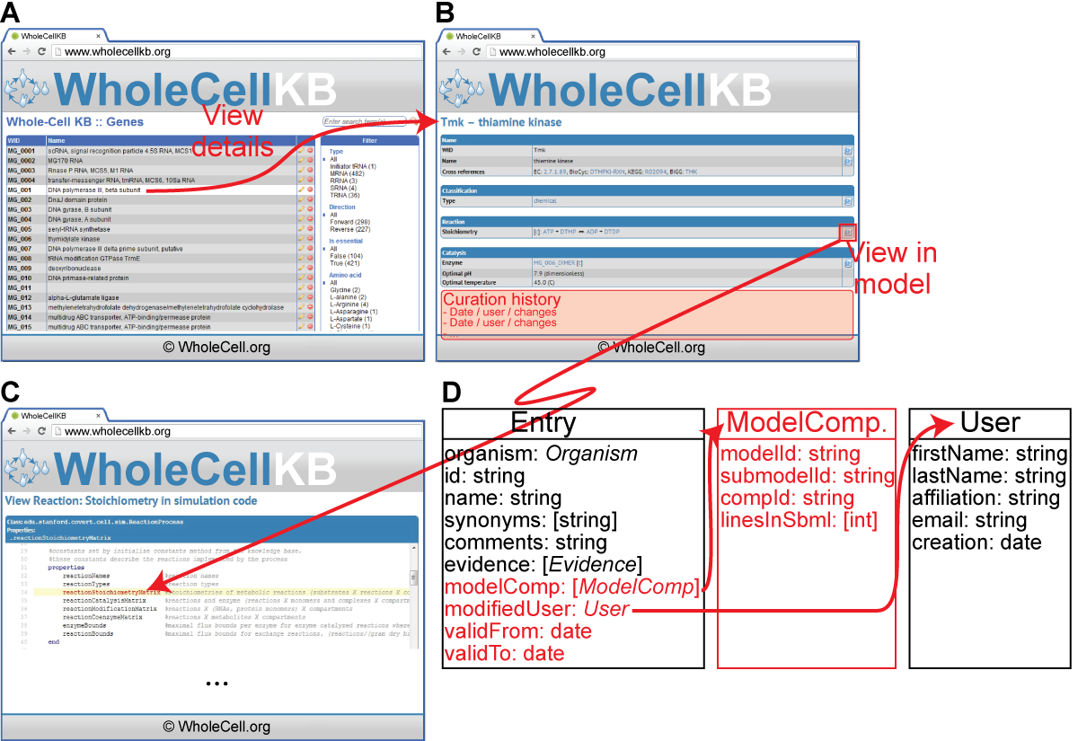
4. Design submodels

Slide 20
5. Map submodels onto common state
Automatically handled by designing submodels from common PGDB

Slide 21
6. Simulate

Slide 22
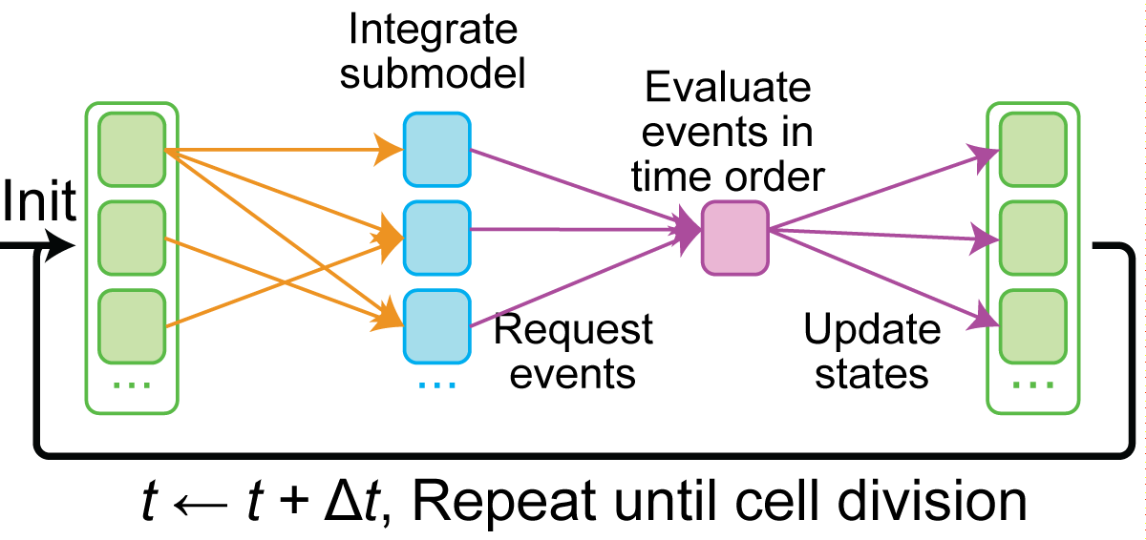
6. Simulate: Concurrently integrate submodels
Goldberg et al., 2016

Slide 23
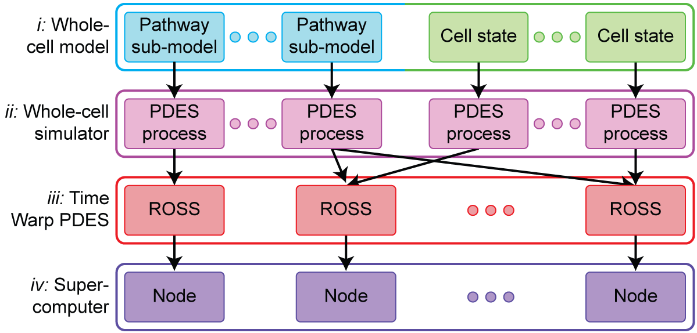
6. Simulate: Parallel discrete event simulation
Goldberg et al., 2016

Slide 24
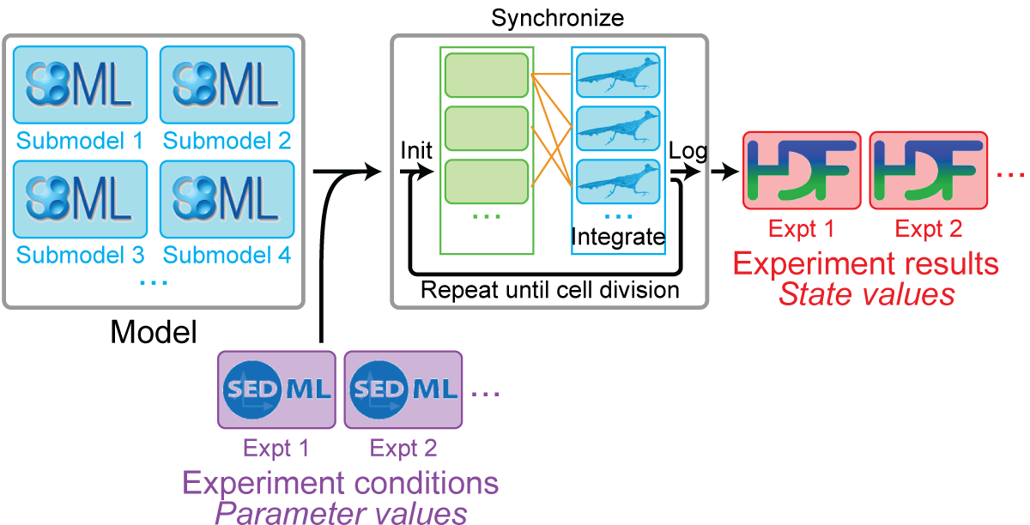
6. Simulate: High-performance simulator

Slide 25
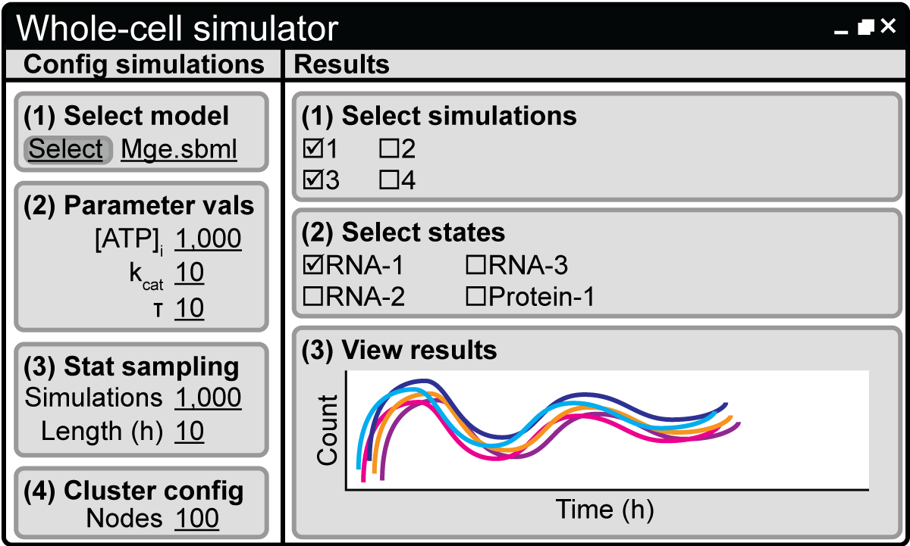
6. Simulate: High-performance simulator

Slide 26
7. Estimate parameters

Slide 27
7. Estimate parameters
Reduce model
Identify reduced model parameters using traditional methods
Experiment
Model
Molecule
Molecule
Manually tune parameters using full model
Cell
Time
Karr et al., 2015

Slide 28
7. Estimate parameters
Automatic model reduction
Distributed numerical optimization
Enabled by
Declarative model description
High-performance simulation

Slide 29
8. Verify model reproduces known biology

Slide 30
8. Verify model reproduces known biology
Matches training data
Cell mass, volume
Biomass composition
RNA, protein expression, half-lives
Superhelicity
Matches published data
Metabolite concentrations
DNA-bound protein density
Gene essentiality
Matches theory
Mass conservation
Central dogma
Cell theory
Evolution
No obvious errors
Plot model predictions
Manually inspect data
Compare to known biology
Notes:
3151 simulations (192 wt, 2959 deletions)

Slide 31
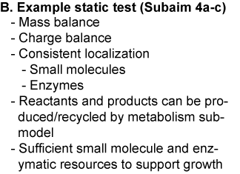
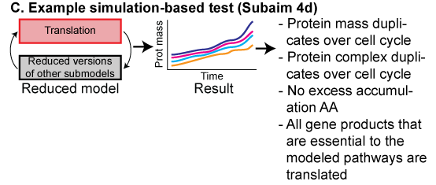
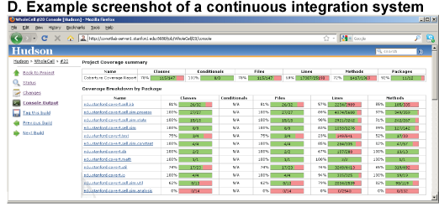
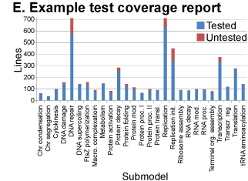
8. Verify model reproduces known biology

Slide 32
9. Validate model reproduces true biology

Slide 33
9. Validate model reproduces true biology
Matches new data
Wild-type growth rate
Disruption strain growth rates
Single-cell division times
Single-cell cell cycle phase lengths
Single-cell sizes
Notes:
3151 simulations (192 wt, 2959 deletions)

Slide 34
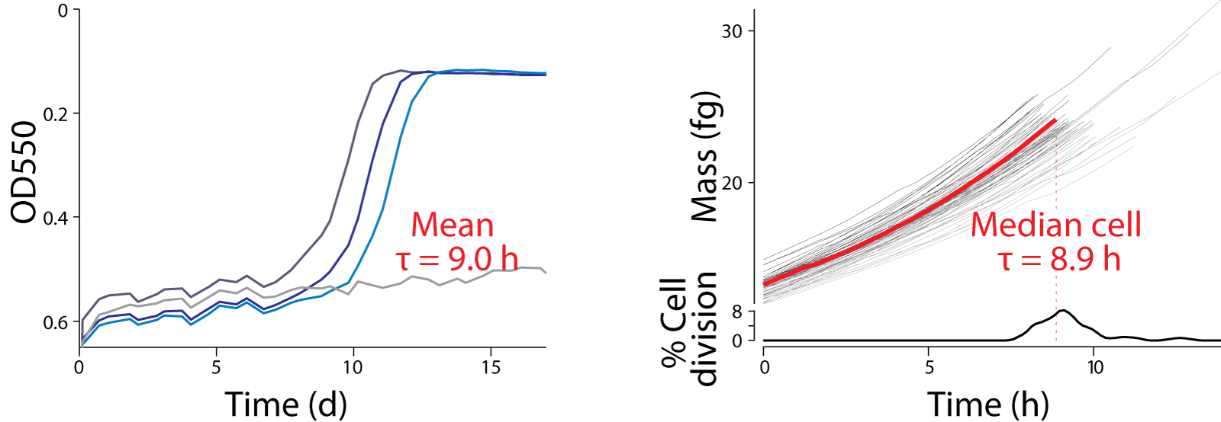
9. Validate model reproduces true biology
Colorimetric growth assay
Model predictions
Karr et al., 2012

Slide 35
10. Visualization & analysis

Slide 36
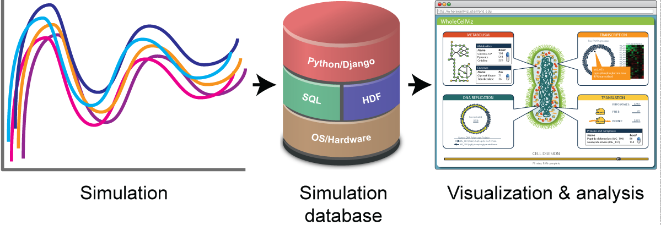
10. Visualization & analysis

Slide 37
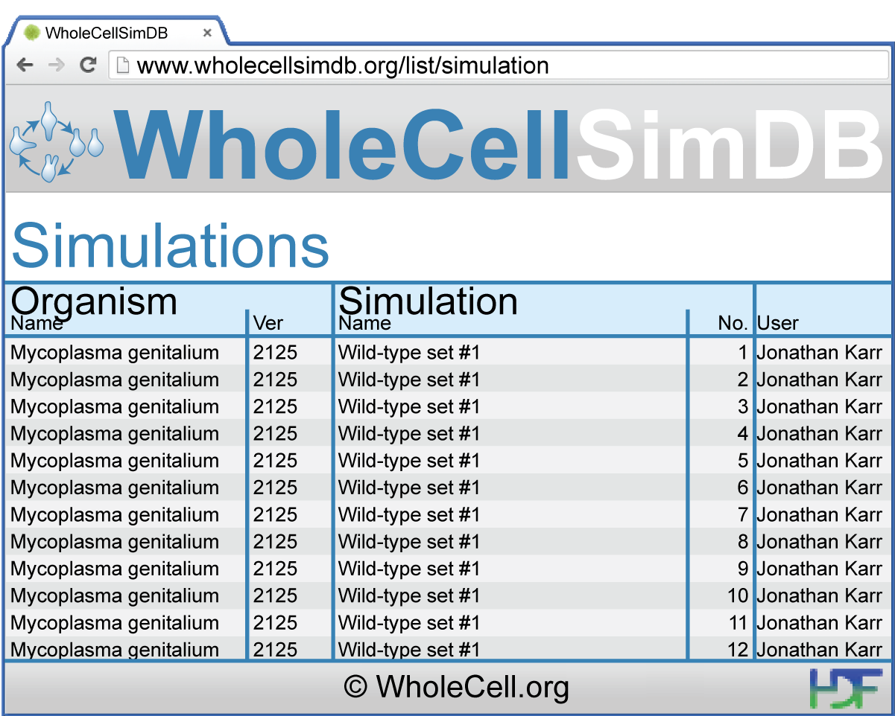
10. Visualization & analysis
Karr et al., 2014

Slide 38
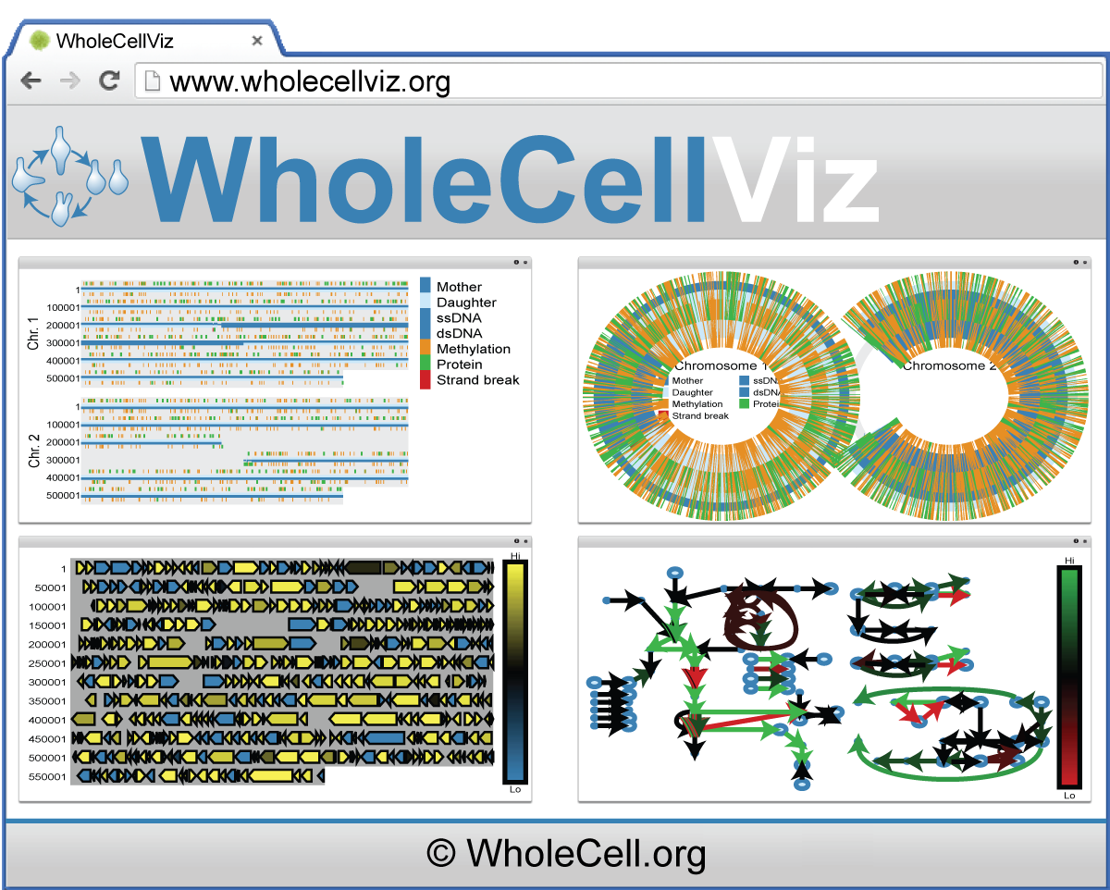
10. Visualization & analysis
Lee et al., 2013

Slide 39
11. Applications: Engineering

Slide 40
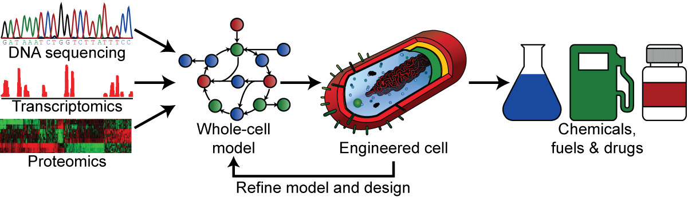
11. Applications: Engineering

Slide 41
11. Applications: Engineering
Synthetic design landscape
Graphical design tool
Clotho, TinkerCell, GenoCAD
(if (nutrients)
(grow)
(sporulate))
High-level language
BioCompiler
Biophysical model
WC models, SCHEMA, MD
Physical implementation
Gibson assembly, TALENs, ZFNs, CRISPR
Transplantation
Transplantation
Directed evolution
Mutate
Select

Slide 42
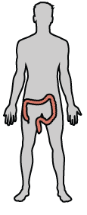
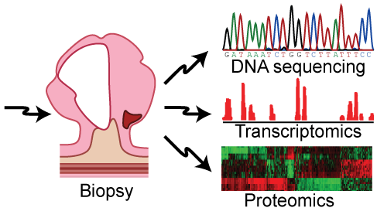
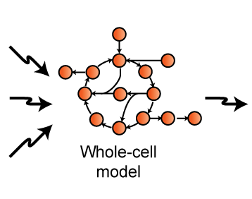
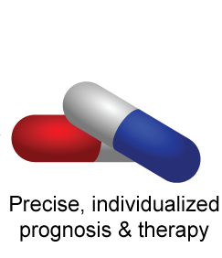
11. Applications: Medicine

Slide 43
Open challenges
 | Challenges
Modeling step | Computational | Experimental | Community
1. Characterize
2. Aggregate data
3. Organize data
4-5. Design models
6. Simulate model
7. Estimate parameters
8. Verify model
9. Validate model
10. Visualize & analyze
11. Engineer
 | Comprehensive metabolomic, proteomic, kinetic data | Diversify experimental effort
Data aggregation software Natural language processing Crowdsourced curation |  | Annotate data Deposit raw data
Design data model which mirrors models
Tools to design models from PGDBs |  | Standard sequence-based, multi-algorithmic language
Determine how to integrate multi-algorithm models Develop high-performance simulator
Automate model reduction Use distributed optimization
Develop test generator Adopt formal verification Use continuous integration
 | Comprehensive single-cell phenomics | Model validation standard
Improved simulation database Data exploration tools
Algorithms to optimize predicted phenotypes Structural integration to design sequences | Methods for large-scale genome engineering Design-build-test automation

Slide 44
Getting involved
Suggested reading
See school website
Many ongoing projects across the field
Contact the lecturers
Community benchmark model project
Contact Jonathan
SysMod ISCB special interest group
SysMod.info
First meeting @ ISMB, July 2016, Orlando FL

Slide 45
Summary
Data
Integrative model
Broadly predicts cell physiology
Integrates heterogeneous data and models
Guides bioengineering and medicine
Opportunities to develop improved methods
Notes:
A central challenge in cell biology is to understand the molecular basis of cellular behaviors, that is:
to understand how cellular behaviors arise from the interactions of biomolecules,
to understand how cellular processes are controlled and coordinated at the molecular level,
to understand how cells allocate limited molecular resources for growth and maintainence,
and more.

Slide 46

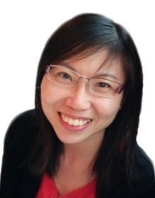









Acknowledgements
Anne Marie Barrette
Yin Hoon Chew
Arthur Goldberg
Graeme Gossel
Pablo Meyer
IBM/Sinai
Roger Rodriguez
UNAM
Center for Regulatory Genomics
Luis Serrano
Maria Lluch-Senar
Veronica Llorens

